Slide 1
Telecom Churn Case Study
Identifying Key Parameter to Retain High Profit Customers and Predicting High-Risk Churn to Minimize Customer Attrition
Partha Pratim Choudhury
IIIT-Bangalore

Slide 2
Introduction
Customer churn is a persistent challenge within the telecom sector, demanding innovative solutions to mitigate its impact. This presentation delves into the core factors driving churn, explores key metrics influencing customer loyalty, and highlights strategic approaches to enhance retention rates. By addressing these issues head-on, telecom companies can transform churn from a pressing problem into an opportunity for growth and improved customer satisfaction.

Slide 3
Problem Statement
Industry Challenge: Telecom companies worldwide are grappling with significant annual churn rates, ranging between 15% and 25%, which pose a serious threat to sustained growth and market stability.

Slide 4
Significance & Objectives
Significance:
Retaining existing customers is far more cost-effective, requiring 5 to 10 times less investment than acquiring new ones.
High-value customers are key drivers of profitability, making their retention critical to long-term success.
Objective:
Evaluating various machine learning models based on their performance metrics to predict customers likely to leave the network.
Pinpoint the key factors contributing to customer churn.
Accurately predict customers at high risk of leaving.
Formulate targeted and effective retention strategies to reduce churn and boost customer loyalty.

Slide 5


Dataset
Source: Public Dataset From a Leading Telecom Company. Key Features: Customer details, usage metrics, and derived metrics. Data shape includes specific numbers of rows and columns after filtering.

Slide 6

Methodology
Dataset Verification & Cleaning:
Steps:
Columns with Missing value:
Imputing categorical columns with mode (a number that occurs most frequently in a dataset )
Imputing missing value in numerical columns with “0”
Other columns like” last_date_of_month_6” , “date_of_last_rech_7”(Refer Notebook for other columns) impute with “0”
Drop the columns that has unique value.
Note:
High Percentage of Missing Values: Delete columns with 70-80% or more missing data, as they contribute little to analysis or modelling.
Unavailable Data for Imputation: Drop columns if missing values can't be reasonably imputed, impacting data quality or model performance.
Etc.
Continued..

Slide 7


Customer Segmentation:
Calculate the Data and voice recharge amount for individual months and calculate the avg. recharge amount.
Determines the 70th percentile of these average amounts.
Filters the DataFrame to retain only the users whose average recharge amount is above this 70th percentile.
Dropping irrelevant columns (Refer Notebook for cols name)
Churn Identification:
The code calculates total usage for a month and then predicts churn based on whether there was any usage or not. If there was usage, the customer is not considered churned (0), and if there was no usage, they are considered churned (1)
Check for any outliers at 25%,50%,75%,90%,95% and 99%

Slide 8

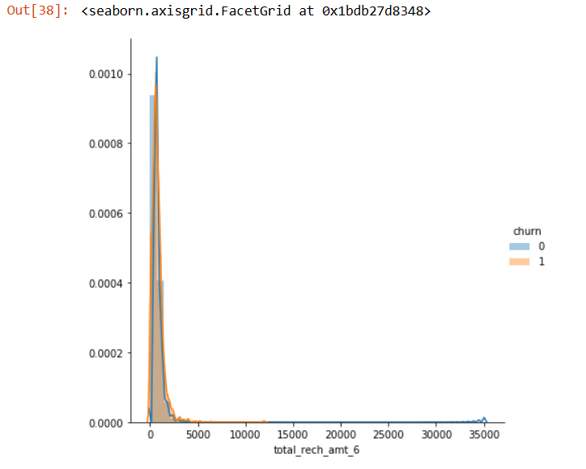
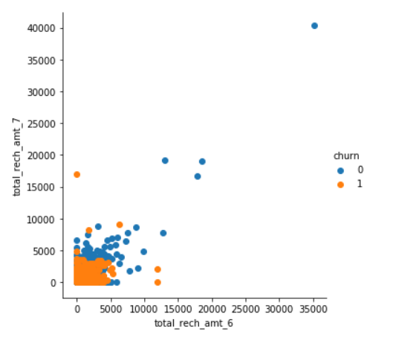
EDA (Exploratory Data Analysis):
Univariate & Bivariate Analysis Check imbalance in data-set (dependent variable)
Using Seaborn visualization library, Histogram/scatter plot the distribution of recharge amounts for churned and non-churned customers, helping to identify potential patterns or differences between the two groups (Non churn & Churn ).
Observations:
Low recharge customer has the probability to Churn more than the high recharge customers
Churn probability higher between no recharge to 1K INR monthly recharge. More than 1K churn % is significantly reduced and No churn customers beyond the monthly recharge of 12K INR recharge.
Observation :
The relationship between recharge amounts for the 6th and 7th months for churned and non-churned customers.
Those customer recharge less than 5K in both months has higher chance to churn. High recharge customer are more loyal to the network.

Slide 9
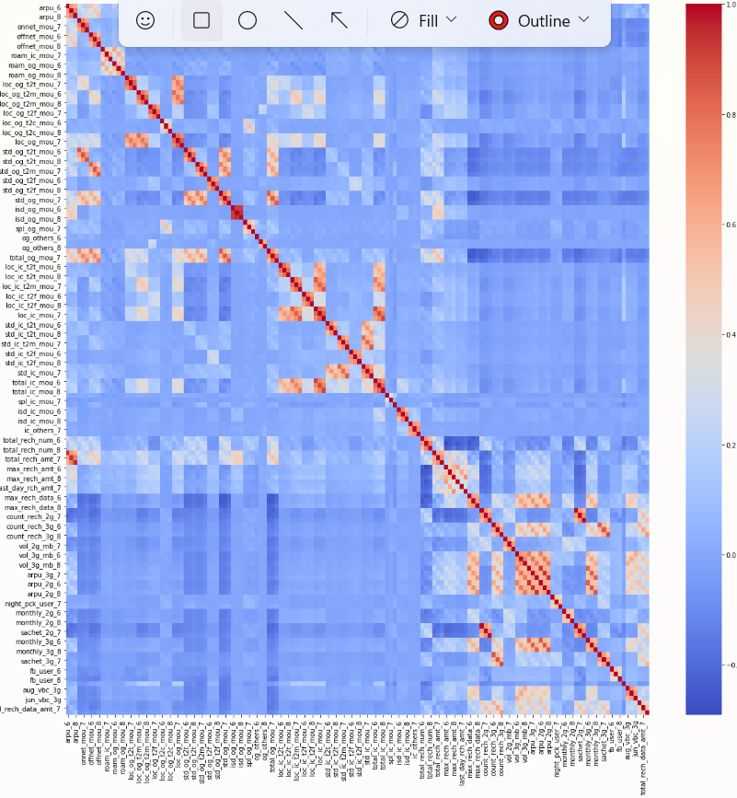
EDA (Exploratory Data Analysis_2):
Correlation Matrix
The purpose of this analysis is to understand the relationships between different features in the dataset. By visualizing the correlation matrix, we can identify:
Highly correlated features: Features with high positive or negative correlations might be redundant and could potentially be removed to reduce dimensionality.
Weakly correlated features: Features with low correlation might not be strongly related and might not contribute significantly to the prediction task.
By understanding these relationships, you can make informed decisions about feature selection and model building.
Observation:
HIGHLY CORRELATED FEATURES IN DATA SET:45, those columns has correlation is > 80%.
SO, We need to use RFE to reduce the features and prepare the dataset for model implementation.

Slide 10

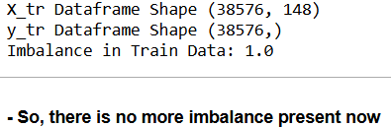
Feature Selection: Recursive Feature Elimination (RFE).
Data Preparation: (Data Standardization/Normalization)
Imports the preprocessing module from the scikit-learn library of Python.
Imports Standardscaler Class
Split Data into Train & Test ( 70 % and 30% ratio)
Note: As we observed that the imbalance data present around 9% in the both train and test data. So, we apply oversampling to balance the train dataset for model.
Import SMOTE module from “imblearn_oversampling” library for balancing the data
Feature reduction using RFE:
Imports the LogisticRegression module from the sklearn.linear_model library
Imports the RFE module from the sklearn.feature_selection library

Slide 11
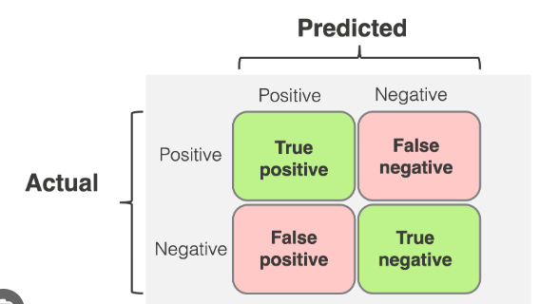
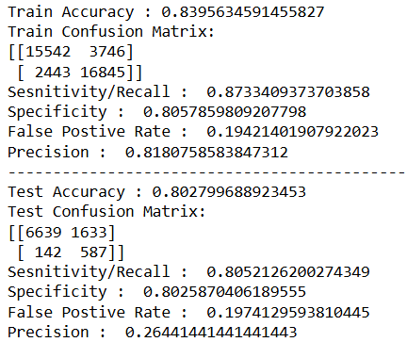
Modeling implementation and Evaluation:
Implement Logistic Regression model on the balanced train dataset
Note: Applied Regression model because our target variables are continuous variables Evaluation: Evaluation method used to find out the performance measures of the ML models are like model accuracy and confusion metrics (Sensitivity/Recall(TP), Specificity(TN), False Positive Rate(FP) and Precision(TP)) .
Observation:
We got 83% and 80% accuracy in Train and Test dataset, so, we can understand that no overfitting in the model and model has perform at excellent level
The parameters in confusion metrics also perform at decent level.
But, the model has drawback in predicting churn as high false positives, which is ~ 19%,
So, we will apply the other Supervised Regression model like Decision Trees and Random
Forest to optimize the model performance.
F1 Score: F1 = 2 * (precision * recall) / (precision + recall) : 81%

Slide 12

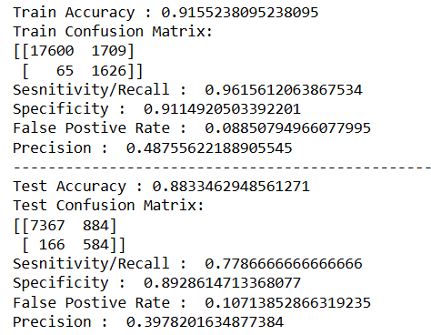
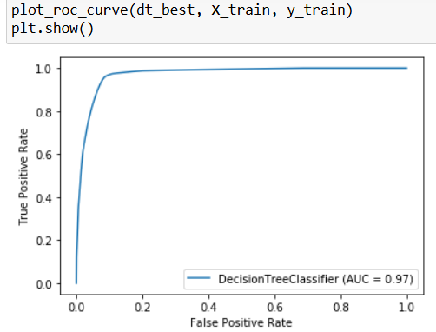
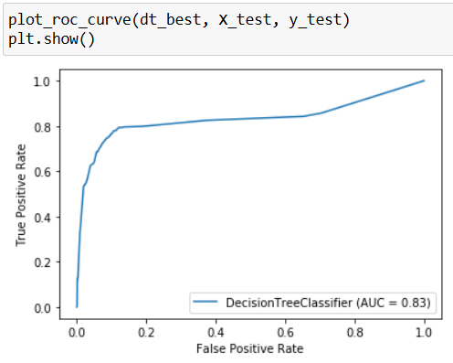
Modeling implementation and Evaluation:
Implement Decision tree on the Train and Test dataset
Observation:
Model Accuracy (88%) on the Test dataset has improved than the Logistics Regression Model
Note:
The Sensitivity/Recall ( Actually Churn customer and model also identify as churn customer) has lower (77%) than LR Model i.e. the churn data is not reliable.
If we compare the ROC (Receiver Operating Characteristic) plots of both Train and Test dataset, we can observed that the AUC parameter (83%) is much lower in the test data compared with train data.
So, we need to implement other ML model to find the best model performance.
F1 Score: F1 = 2 * (precision * recall) / (precision + recall) : 53%

Slide 13
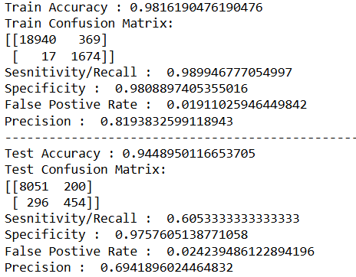
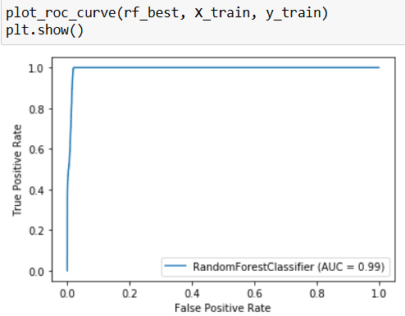
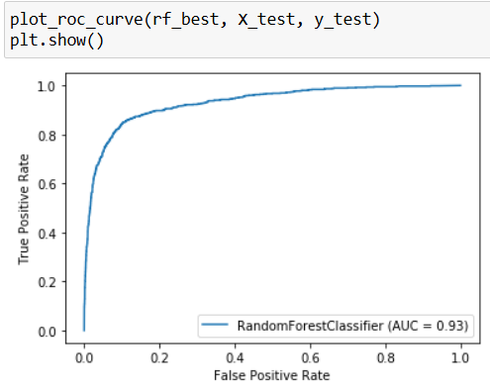
Modeling implementation and Evaluation:
Implement Random Forest on the Train and Test dataset after Hyper-parameter tuning
Observation:
Model Accuracy (94%) on the Test dataset has improved than the Logistics Regression Model as well as Decision Tree.
If we compare the ROC (Receiver Operating Characteristic) plots of both Train and Test dataset, we can observed that the AUC parameter is on the higher side in the test data compared with Decision Tree.
Note:
The Sensitivity/Recall ( Actually Churn customer and model also identify as churn customer) has much lower (61%) than LR Model i.e. the churn data is not reliable.
F1 Score: F1 = 2 * (precision * recall) / (precision + recall) : 65%

Slide 14
Final Analysis :
1. We observe for Decision Tree, the Accuracy is about 88%, Sensitivity is 78% while AUC is at 83%. Since the sensitivity is low, the churn data is not reliable
2. Random Forest the Accuracy is about 94%, Sensitivity is at 61% and AUC is at 93%. Since the sensitivity is low, the churn data is not reliable.
3. For Logistics Regression, the Accuracy is 80%, Sensitivity is 80% and F1 score is about 91%.
As the F1 Score is very high coupled with Accuracy being high as well, we conclude that Logistic Regression Model is the best model to predict churn
Recommendations to Business:
1) We can clearly infer that incoming & outgoing calls within a circle is key for identifying churn customers, specially the usage during the action phase when compared to good month (7th month) has reduced
2) The other key factor is if the recharge amount shows a dip in the action phase it signifies a churn of the customer
3) Age on network is also a key indicator for identifying the churn, if “aon" is less than 500 days and their usage is reduced, it indicates the customer is about to be churned
4) The usage of mobile data has also reduced when compared with 7th month. So, data usage & amount can also be the other features for understanding the churn behaviour

Slide 15
Conclusion
Identified high-risk churn customers using predictive models. Implementing proactive retention strategies can significantly reduce churn. Next Steps: Real-world deployment of models, continuous monitoring, and model refinement.

Slide 16
Q&A:
Invite questions and discussion on the case study.

